Slide 1
THE SECRET LANGUAGE OF LINES
A Curriculum to Attain Graphicacy
Lucia Hasty, MA, TVI
Rocky Mountain Braille Associates

Slide 2
Lucia Hasty, MA, CTVI
Braille & Tactile Graphics
Consultant and Trainer
Rocky Mountain Braille Associates
www.tactilegraphics.org
www.rockymountainbraille.com

Slide 3
Today’s Discussion
Why teaching graphics is important
Skills to learn for reading and writing
Activities to facilitate learning
Resources for learning to read graphics
What else do you need to successfully teach TGs?

Slide 4
Graphicacy
What does that mean?????
Read and write
Interpret and apply
Demonstrate knowledge graphically

Slide 5
Why is it important?
“Tactile graphics can give direct access to what is otherwise inaccessible.”
Reader will be able to
access text materials
understand full meaning of content
fully participate in this facet of literacy
diffuse test anxiety
feel confidence in test-taking ability

Slide 6
Building Mental Images
The learning process:
Concrete
Manipulative
Abstract

Slide 7
Building Mental Images
1. Exposure
2. Experience
3. Exploring
4. Enthusiasm

Slide 8
1. Exposure
Active involvement with others in the environment
Experience, as opposed to “just” language
Developing concepts of “chair-ness”, “nose-ness”
Begin to Identify characteristics and features of things encountered

Slide 9
From Teaching Touch by Lois Harrell

Slide 10
2. Experience
Opportunity to tie things exposed to together
Begin to establish how they are related
Manipulate within the environment
(using manipulatives vital!)
Match language with experience

Slide 11
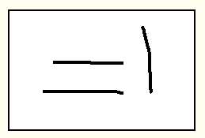

Slide 12
Role of Language
4 C’s of Communication:
Compare
Categorize
Comprehend
Communicate
Notes:
London bus story

Slide 13
Successful Manipulatives
  Sized for age/size of student
  Sturdy- will withstand repeated handling
  Will “stay put”
  Organized storage and retrieval

Slide 14
3. Exploring
Independently explore with intent of gathering information
Requires
  Spatial awareness
  Organized scanning skills
  Part-to-whole assembly
  Tactual discrimination (identifying symbols, selecting landmarks)
  Language skills (labels, etc.)

Slide 15
4. Enthusiasm
Success at finding information independently
Curiosity increases
Becomes “do-er” as opposed to “done to”
Positive self-concept

Slide 16
Successful Readers Ask:
1.Where am I?
  Look for title
  Scan whole graphic and key
  Identify a point of reference
  2. Where am I going?
  Look for important clues, prominent textures
  Compare area textures, trace major and minor
  lines, examine point symbols

Slide 17
Successful Readers Ask, cont’d:
3. What am I looking for?
    Search key for details
    Read labels
4. How do these pieces fit together?
  Actually starts reading the graphic rather than scanning it.
  Moves more slowly and intently
  Begins to put parts into whole picture

Slide 18
Tasks in Decoding a Graphic
Understand intent of graphic
Decode symbols
Interpret content of graphic
Apply content to task

Slide 19
Preparing for emerging resources
Descriptions in lieu of tactile graphics
Audio-tactile instructional aids
    SmartPen technology
    Touch tablets- TTT and IVEO
Graphics embossers and software

Slide 20
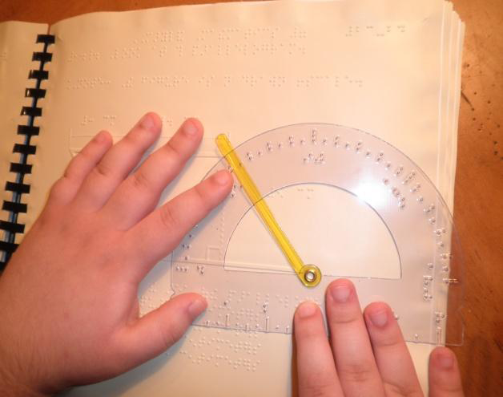
Maryland Common Core State Curriculum Frameworks for Braille
Mathematics
Maryland State Department of Education 2012

Slide 21
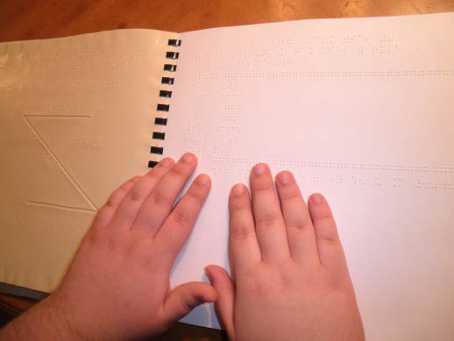
MARYLAND COMMON CORE CURRICULUM
FRAMEWORKS FOR BRAILLE
Braille, Formatting, and Tactile Graphics
Checklists By Grade
Maryland State Department of Education 2012

Slide 22
Other resources
Braille Mathematics Standards
California State Board of Educational 2006
Test Ready Plus Mathematics
Curriculum Associates 2005
Tangible Graphs
APH 1986

Slide 23
The Secret Language of Lines
Authors: Lucia Hasty and Dawn Wilkinson
  With additional activities from Ann Cunningham
Concepts (teacher directed)
Activities to teach the concepts
Resources and teaching tools/materials
Skills required by grade level
Skills checklists for assessment and progress records
Student activities

Slide 24
From a Visually Impaired Child’s Perspective
“I think I know what it’s like to see:
It’s like telling the future because you know now that there will be a tree and I will know later, when I come up to it and touch it”

Slide 25
Thank you for coming today
Lucia Hasty
Lucia@TactileGraphics.org

